Slide 1
TOKOPEDIA STRATEGIC REVIEW 2024
Promo Efficiency & Retention churn Analysis
A data-driven roadmap to curb promo budget waste, fix fulfillment SLA breaches, and protect long-term customer retention.

Slide 2
TABLE OF CONTENTS
Presentation Structure & Analytical Roadmap
SECTION 01
SECTION 02
SECTION 03
SECTION 04
SECTION 05
Executive Summary
Data & Business Context
Data Quality Audit
Exploratory Analysis
Strategic Roadmap
Strategic context, CLV:CAC erosion, and core diagnostics.
Market landscape, GoTo efficiency precedent, and scope.
Sanitization of corrupt timestamps, SLA logs, and types.
Promo leakage, channel ROI, and logistics churn cliff.
Milestone incentives, carrier SLA contracts, and targets.

Slide 3
EXECUTIVE SUMMARY
Key Diagnostics: GMV Scale vs Margin Health
Unit Economics Erosion
Retention Contraction
Post-Purchase Friction
CLV:CAC drops to ~1.2x during major WIB promo campaigns.
90-day repeat order rate contracted from ~40% to below 25%.
First-order delivery failure triggers severe long-term churn.

Slide 4
BUSINESS UNDERSTANDING
Growth Dilemma: Market Share vs Cash Discipline
GoTo Group Precedent
Discount Seeker Dominance
Users transact strictly on coupon availability and leave when subsidies end.
A corporate incentive cut of Rp2.8T mandated a shift toward high-quality, profitable users.
Margin Cannibalization
Tokopedia holds 34% of national GMV ($65B) but faces a consumer base with 51% discount seekers.
Upfront price slashing fails to cultivate sticky organic shopping habits.

Slide 5
DATA UNDERSTANDING
Scope of Data & Core Analytical Entities
24 Months
50K+
5 Tables
Transaction Window
Unique User Profiles
Integrated Vectors
Jan 2023 – Dec 2024
Distinct Users
Transactions, users, deliveries, sellers and CS

Slide 6
DATA QUALITY AUDIT
Sanitization Logic & Missing Value Strategy
Entity / Column | Raw Data Issue | Imputation / Treatment Applied | Analytical Impact
users.gender & referral | Missing categorical records | Filled with 'unknown' & 'no referral' | Zero user row drop on joins
transactions.voucher_type | Nulls when promo_amount = 0 | Set 'no voucher' if 0, else 'unknown' | Clear promo classification
courier_rating & csat_score | Missing numerical values | Median imputation per attribute | Robust against skewed outliers
Timestamps (1970/2030) | Corrupt dates & dispatch date < order date | Filtered to 2023–2024 sequence | Accurate SLA calculation
Typecast & Deduplication | Decimal SQL types & same-day rows | Cast to float + first-order flag dedup | Exact Python vs Tableau parity

Slide 7

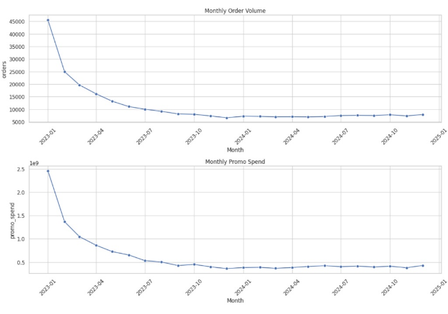
HISTORICAL TREND ANALYSIS
Monthly Order Volume vs. Promo Spend Burn
Post-Subsidy Volume Contraction
Orders dropped from 45k to 7k as early promo burn cooled down.
Stabilization Plateau
Volume found steady organic baseline around 7k–8k orders throughout 2024.

Slide 8
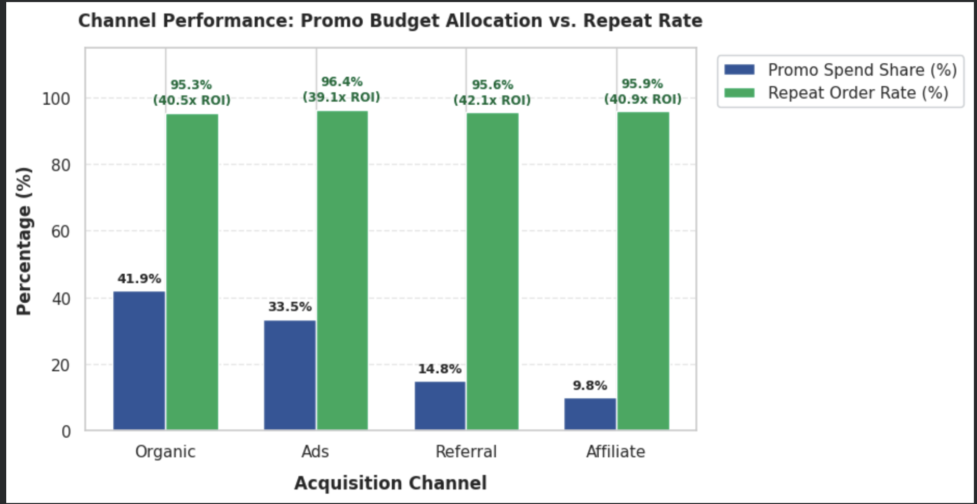
CHANNEL ALLOCATION
Acquisition ROI & Channel Performance
Channel | Promo Spend Share | Repeat Order Rate | Return on Promo | Strategic Action
Ads | 33.5% | 96.4% | Lowest (39.1x) | Maintain as baseline
Organic | 41.9% | 95.3% | High (40.5x) | Scale SEO & search
Referral | 14.8% | 95.6% | Highest (42.1x) | Incentivize loops
Affiliate | 9.8% | 95.9% | High (40.9x) | Introduce more Affiliate

Slide 9
AUDIENCE COMPOSITION
Promo Budget Allocation by Customer Segment
Discount Seekers (Churned)
42.5%
Promo-Driven Loyal
28.0%
High-Value Loyal
18.5%
One-Time (Low Promo)
11.0%

Slide 10
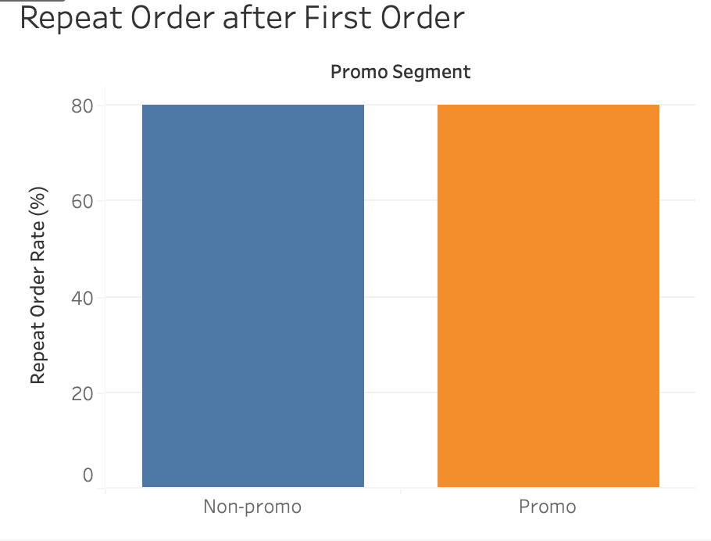
RETENTION COHORTS
90-Day Repeat Order Rate by First Purchase Promo
Promos Do Not Drive Retention
Subsidizing the first order produces identical repeat purchase rates as organic buyers.
Capital Misallocation
Upfront subsidies subsidize baseline demand rather than habituating usage.
Non-Promo Cohort
Promo Cohort
76.5%
76.6%
19,705 Users
27,671 Users
Difference is statistically insignificant (+0.02% variance).

Slide 11
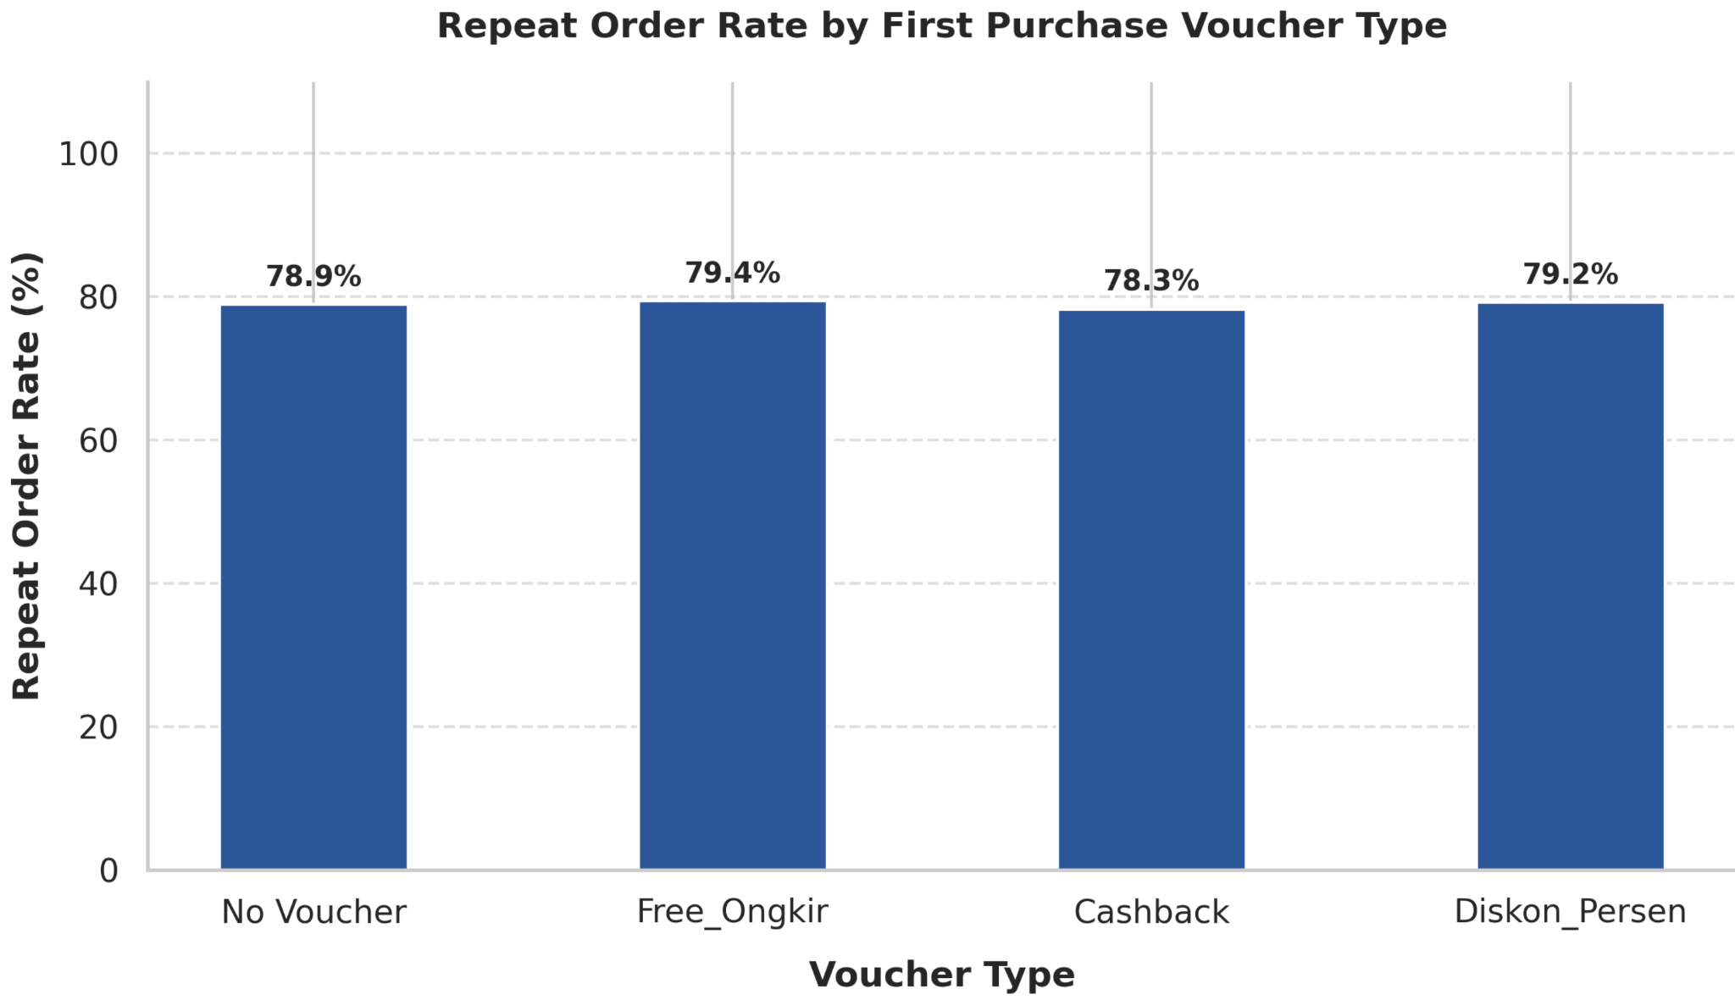
VOUCHER TYPE ANALYSIS
Repeat Order Rate Across Voucher Types
Similar Retention Across Types
No Voucher (78.9%), Free Ongkir (79.4%), Cashback (78.3%), and Diskon Persen (79.2%) yield virtually identical repeat rates.
Subsidies Subsidize Baseline Demand
Users acquired without any voucher return at the same frequency as users given expensive cashback or free shipping.
Reallocation Opportunity
Eliminate broad first-purchase voucher blasts and reserve subsidies for Milestone 2nd-order triggers.

Slide 12
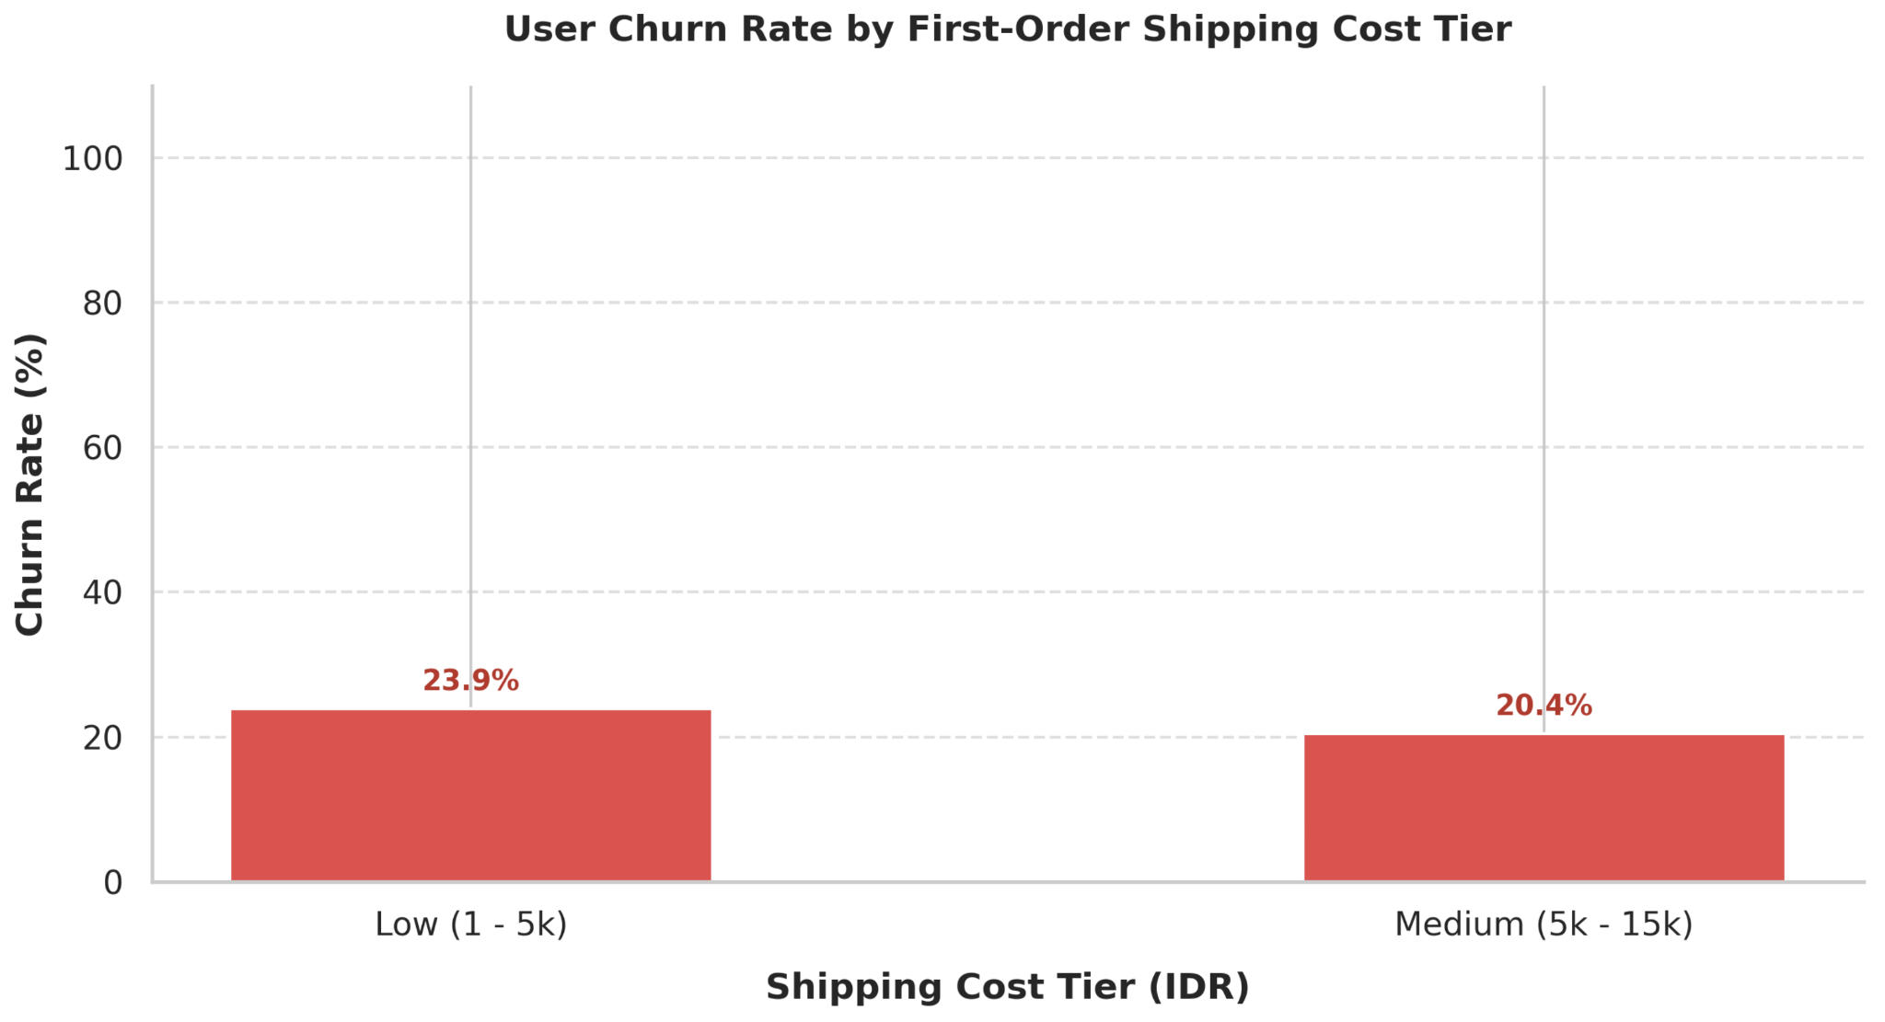
SHIPPING COST SENSITIVITY
User Churn Rate by Shipping Cost Tier
Stable Churn Across Price Tiers
Low shipping fees (1k–5k) produce 23.9% churn, while Medium fees (5k–15k) produce 20.4% churn.
Shipping Fee Is Not the Primary Churn Driver
Users tolerate moderate shipping costs without dropping off; churn is instead driven by delivery speed and courier rating.

Slide 13
PART II
The Logistics Bottleneck & SLA Impact
Why delivery performance is the real hidden driver of platform retention.

Slide 14


OPERATIONAL FRICTION
First Delivery Experience Dictates Retention
On-Time Delivery
Late Delivery
83.0%
71.6%
Repeat purchase rate within 90 days.
11.4 percentage point retention drop.

Slide 15
QUALITY METRICS
The Courier Rating Churn Cliff
Poor (< 3.0)
Average (3.0–4.0)
Good (4.0–4.5)
Excellent (4.5–5.0)
69.6%
24.5%
15.7%
20.4%
Severe churn rate.
Moderate churn risk.
Lowest overall churn.
Stable high-volume core.

Slide 16
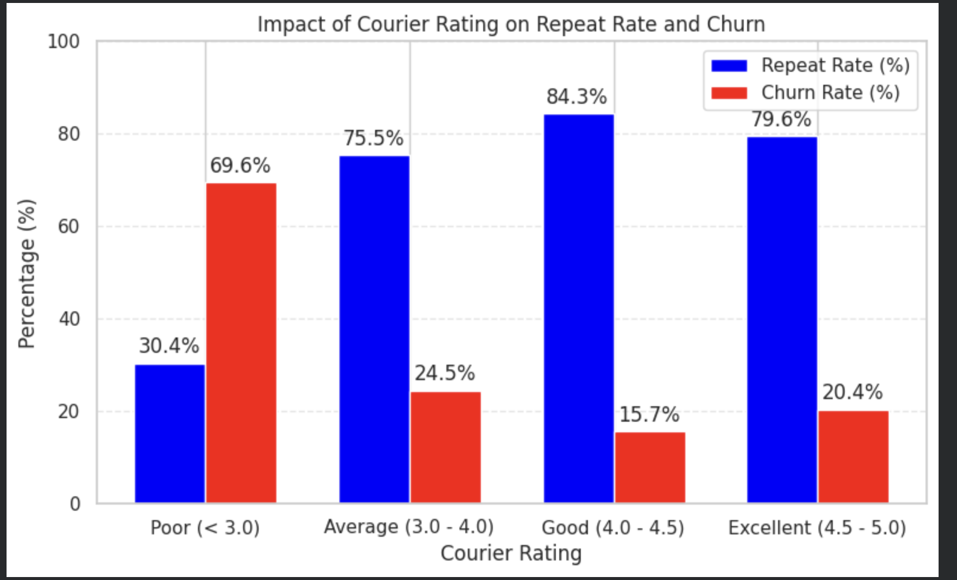

SUPPLY CHAIN REALITY
Logistics Reliability as a Marketing Channel
Service Deficit Negates Promos
No promo size overcomes a broken delivery promise.
Partner Accountabilities
Bottom-tier couriers degrade platform retention.
SLA Subsidies
Tie free shipping directly to courier SLA compliance.

Slide 17
STUDY BOUNDARIES
Strategic Recommendations & Action Plan
PHASE 1
PHASE 2
PHASE 3
Promo Restructure
Logistics SLAs
Referral Scaling
Milestone cashback on order #2.
Auto-penalties on late couriers.
Reallocate budget to advocacy.

Slide 18
Boundaries & Limitations
Limitations & Analytical Constraints
Cohort Horizon Cap
Observational Bias
Unobserved Competitor Pricing
90-day window limits multi-year LTV visibility.
Historical trends lack randomized A/B holdouts.
No external price benchmark against Shopee or TikTok.

